Slide 1
Studiosity
Overview

Slide 2

Enhancing Online Tutor support – Studiosity pilot
01
Introduction
Writing Feedback
Connect Live
Overview of platform
Partner Portal
02
03
04
05

Slide 3
Introduction
Purpose: enhance the student experience and academic performance by offering on-demand, academic support through two services:
Writing Feedback on assessment drafts and Connect Live.
Performance
Progression
Retention
Satisfaction
01
02
03
04

Slide 4
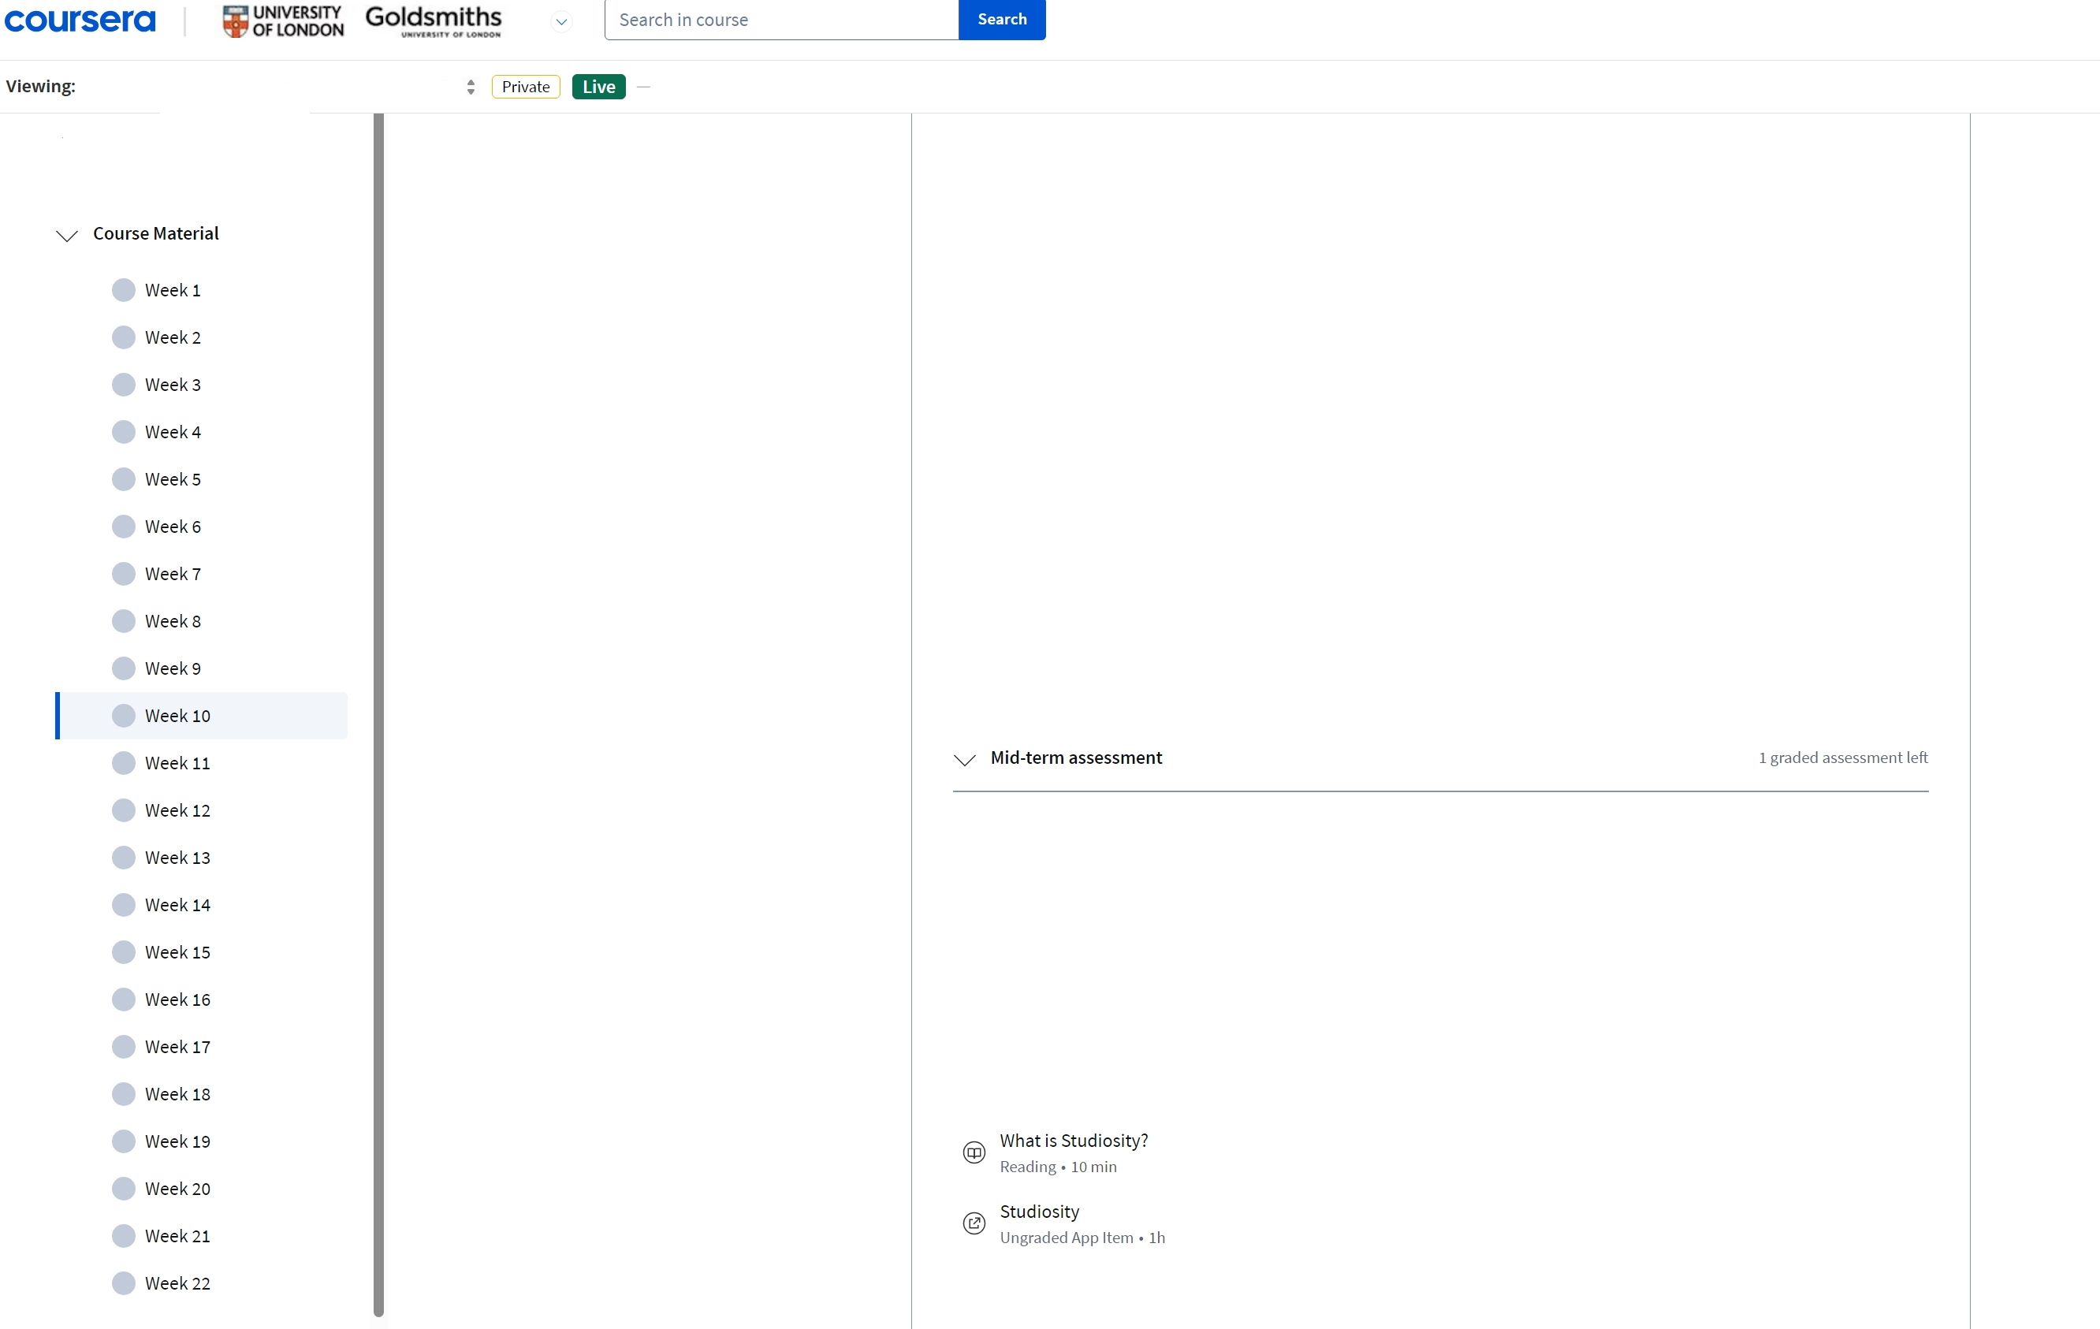
Where is the Studiosity link?
The link to Studiosity can be found in the mid term assessment section of Week 10 of the module.
Simply click the link and log in with your student credentials.

Slide 5
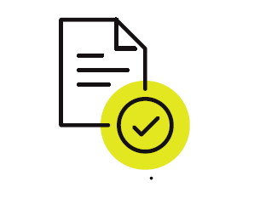
Writing Feedback
Review of submitted assignment drafts on academic literacy.
Feedback returned within a maximum of 24 hours, 24/7.
Citation assist checks for plagiarism and use of references.
Service does not offer review of content, editing or proofreading.
Focus area(s)
Structure
Language
Argument/Idea development
Spelling and grammar
Use of sources
Document types
Academic Writing Evaluation
Business letter
Business Report
Case Study
Essay
Reference list

Slide 6

Connect Live
On-demand academic support, 24/7.
Students connect to a specialist; formulates their own questions and work with a Subject Specialist in an interactive classroom using typed or audio chat; collaborative whiteboard and file sharing.
Subject topics covered by Connect Live specialists that may be relevant to students:
English
Support for core English skills and concepts including core skills; essay and report writing; creative writing; speeches and generic text analysis.
Maths
Potentially beneficial to students on modules which include maths topics.
Study Coach
Support for essential/study skills, such as work planning, revision timetables, study hints and tips, assignment and project research, note taking, and online & database search skills.

Slide 7
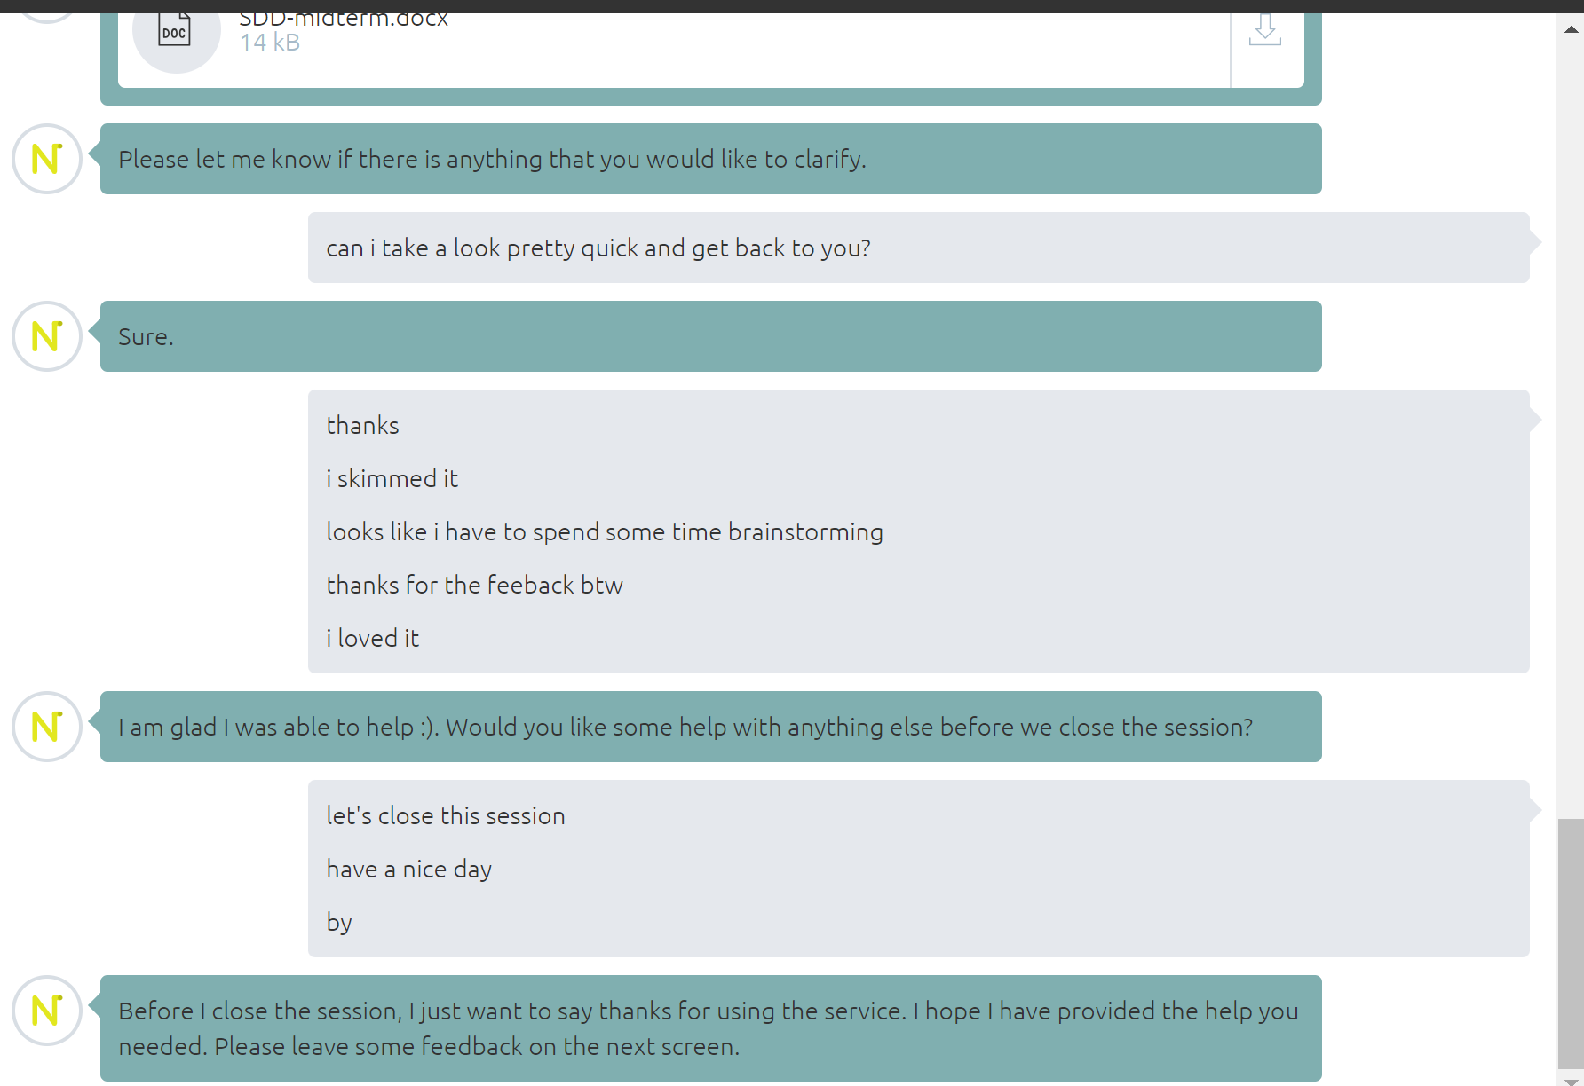
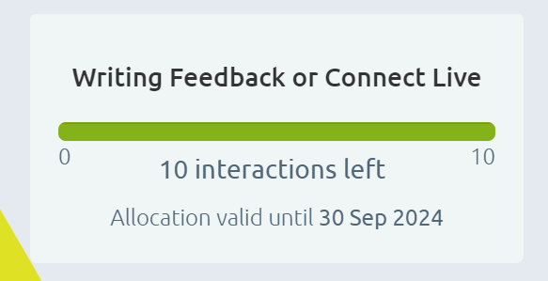
Usage allocation
Example of Connect Live session from a UoL student.
Students granted 10 interactions per study session.
Connect Live fair usage policy warning:
“Your fair use limit is 20 minutes. If you've passed the 20-minute mark and you have a second question, you'll need to reconnect to ensure everyone gets a go.”

Slide 8
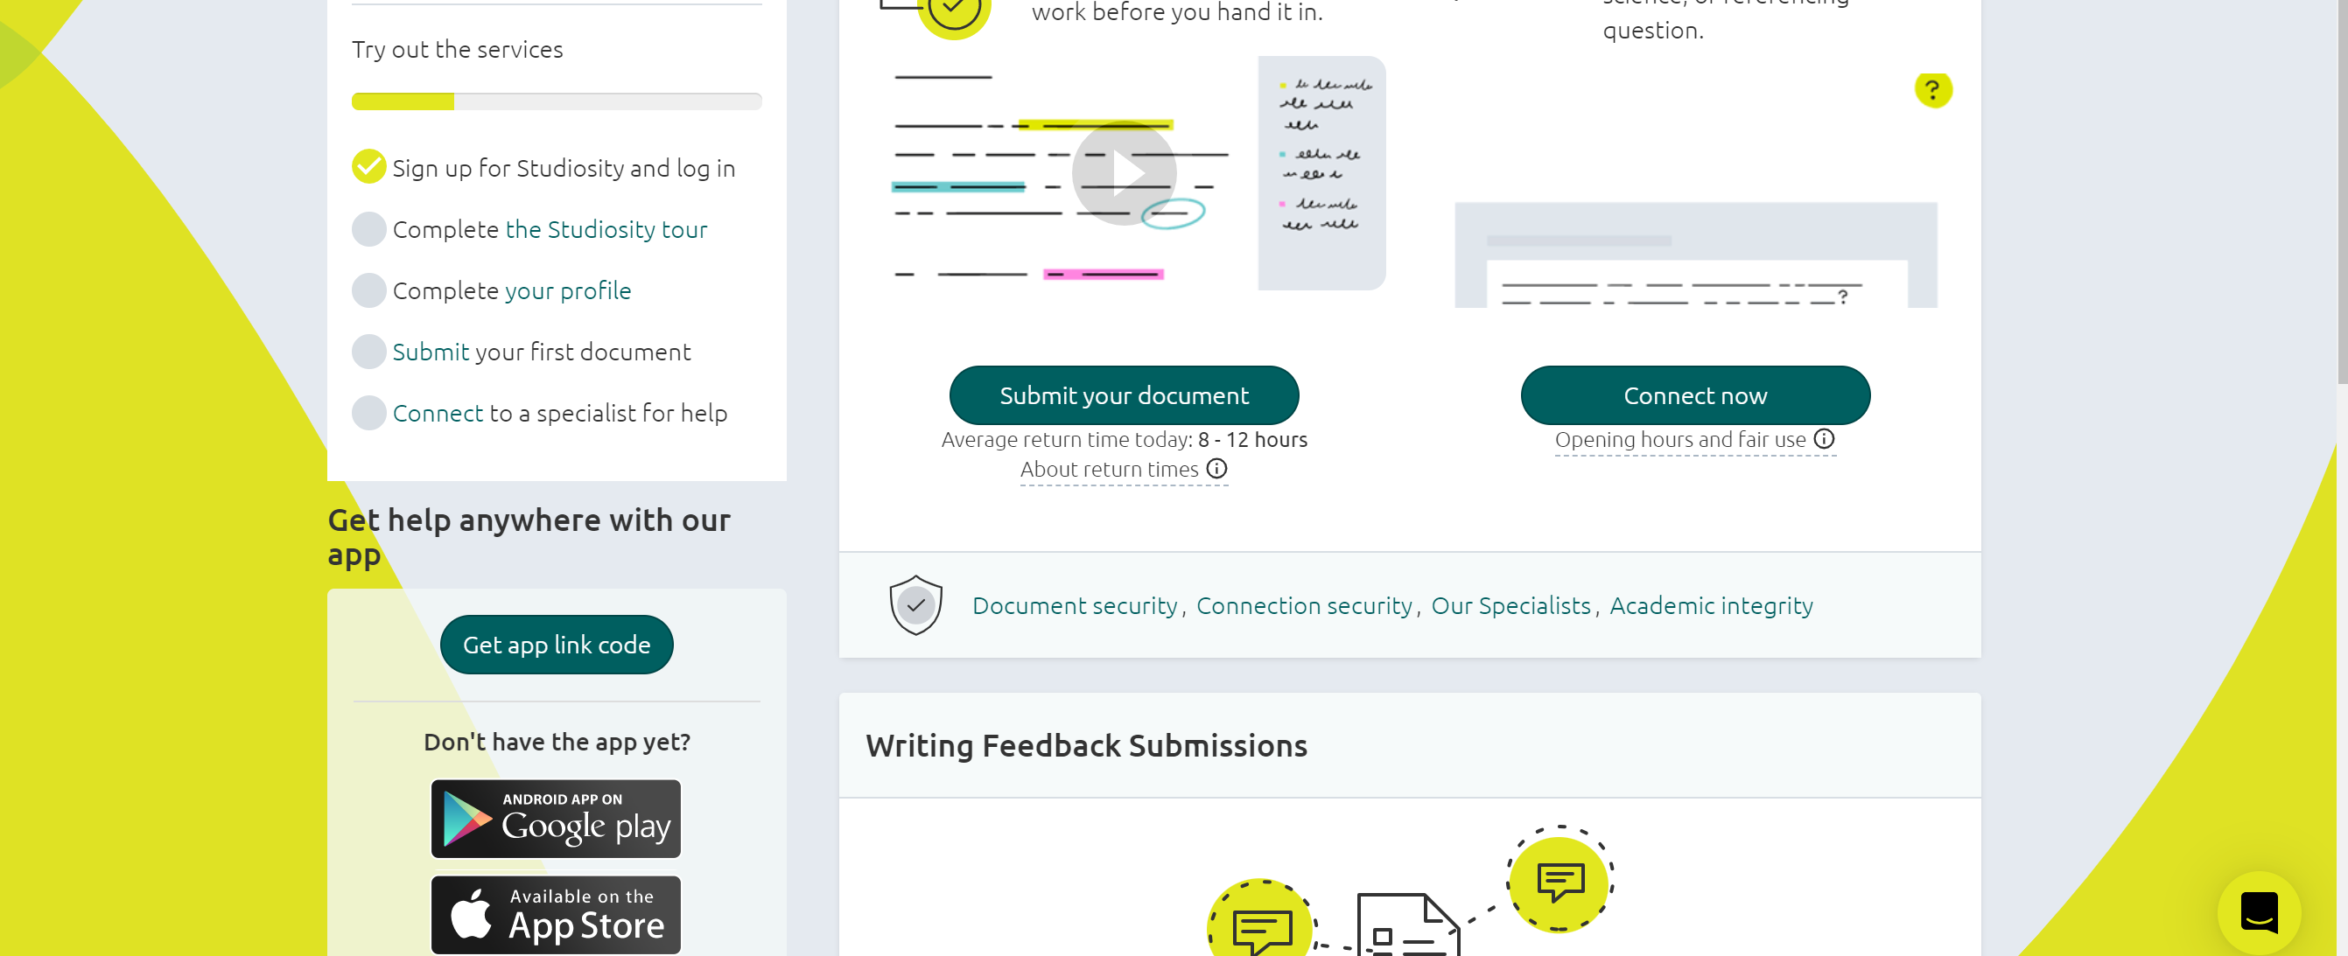
Overview of platform

